Slide 1
The role of tissue-specific antigens in different cancer entities
Analysis of Csn Genes
Supervisor: Dr. Maria Dinkelacker
Tutor: Nils Mechtel
Subject: Data Science SoSe 2021
Date of Presentation: 12.05.2021
Participents: Anastassia Fink, Andreas Breuß, Yuan Sun, Leon Hornich

Slide 2
Biological Background

Slide 3
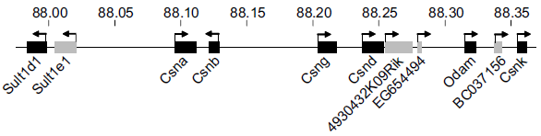
Casein Genes (CSN)
Casein genes: Csna, Csnb, Csng, Csnd, Csnk
Casein genes: Csna, Csnb, Csng, Csnd, Csnk
Temporarily regulated during late pregnancy and postpartum lactation period (-> horome dependent)
TRA restricted to mammary gland epithelial cells (MEC)
Located in the casein gene region on chromosome 5

Slide 4
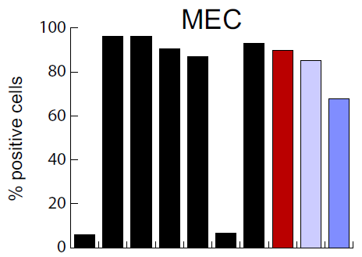

Correlation with other genes
Csna, Csnb, Csng, Csnd, Csnk
-> Coexpressed in MEC
Functionally related genes: lactalbumin-α (Lalba), whey acidic protein (WAP) and Elf5
-> These genes show correlated expression
with Csn in MEC
Colocalized genes: Sult1d1 and Odam
-> These genes show no correlated expression
with Csn in MEC

Slide 5
Data Exploration

Slide 6
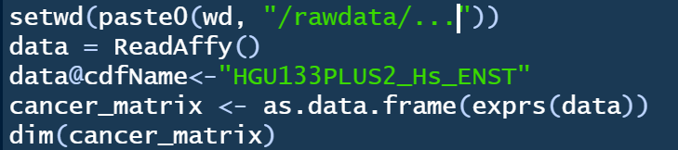
How does our raw data look like?
Lung Cancer Data Set | Breast Cancer Data Set
12 columns
20 columns
1354896 rows
1354896 rows

Slide 7

Structure of our data
Data
Lung Cancer
Breast Cancer
Tumorous
tissue
Non tumorous
tissue
TNBC
LumA
Her2
LumB

Slide 8
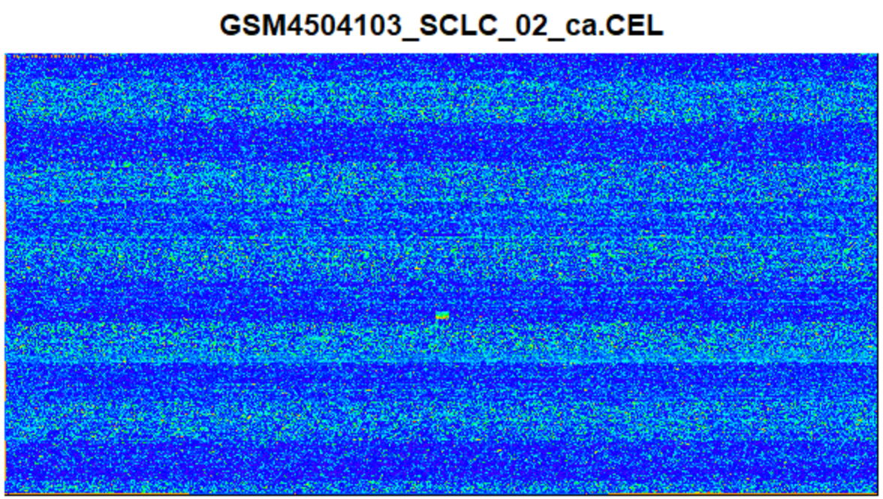
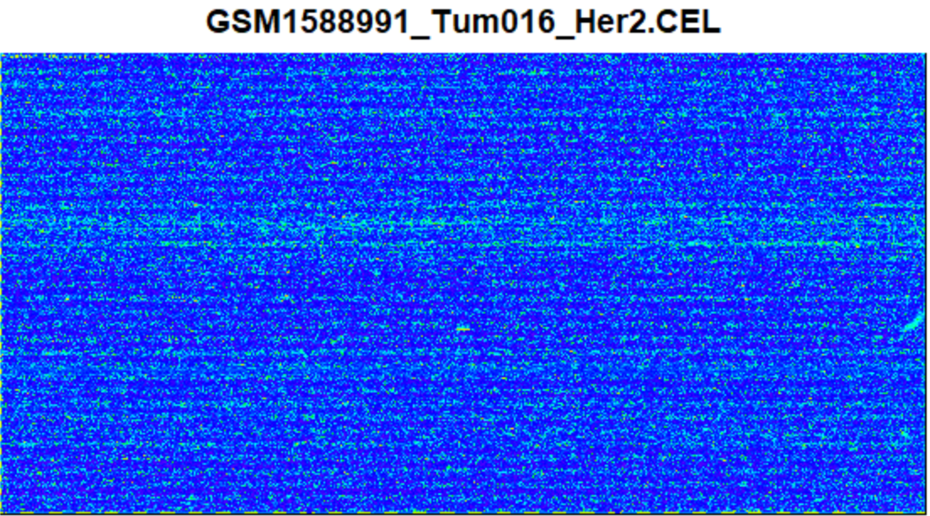
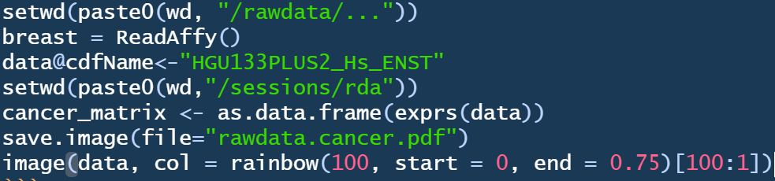
Can the microarray chips be used?
Lung Cancer Data Set | Breast Cancer Data Set
- Small Fragment
- Small Fragments
- Found on 12/12
- 1/12 Chips
- Found on 11/12
Chips
- Can be worked
Around?
- Can be worked
around

Slide 9
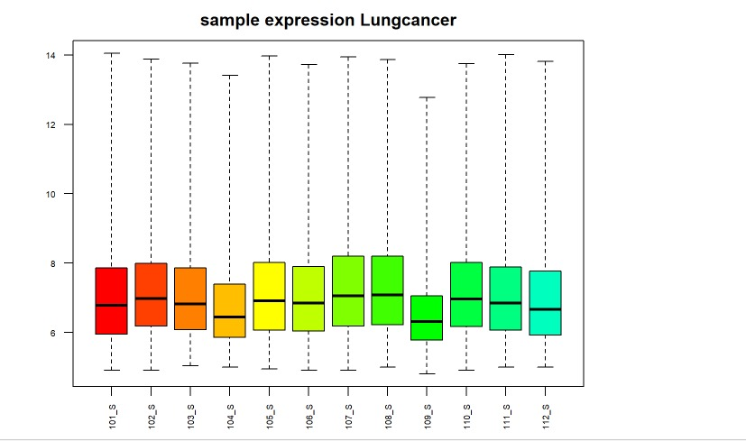
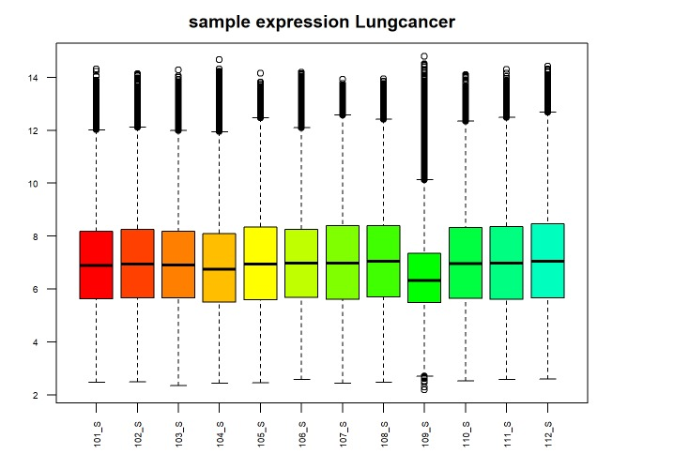
Data Boxplot
Before the normalization
after the normalization
Low level of expression
origin of the sample (really from tumor cell)?
Lots of intreme values
artificially factor?

Slide 10
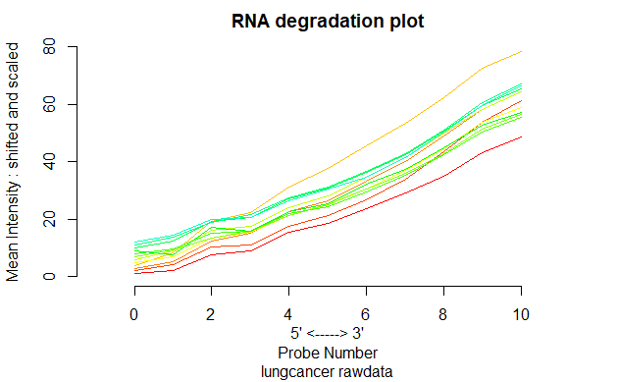
Rna degradation plot
Chips needed to be replaced with the data cleanup
Overlap because of two abnormal chips?

Slide 11
Goals
We want to determine, weather Casein genes are up-regulated in breast or lung cancer potentially good target for cancer immunotherapy
Furthermore we want to evaluate if overexpression is limited to a specific loci in cancer cells

Slide 12
Data analysis
Are genes of interest overexpressed in cancer in comparison to healthy samples?
Is there a possible conclusion from one gene to another?
Visualize our data.
Which gene store´s the most information?
How do our findings correlate with reference literature in general?
Heatmap
T-test
PCA
Regression

Slide 13
Heatmap
PCA
F-test
Correlations
18.05.
02.06
23.06.
25.05.
09.06
06.07.
Completion of data clean-up
One-sided upper t-test
Regression model

